Slide 1
Quantum Machine Learning (QML) and Quantum Artificial Intelligence (QAI)
Yifeng

Slide 2
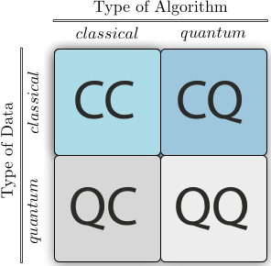
Instead of processing information in terms of 1s and 0s—called bits—and doing it serially, which is how classical computing works, quantum computers use qubits which can represent a 1 and a 0 simultaneously. Like a guitar, bits are similar to playing one note at a time, whereas, qubits play several notes together. With enough qubits, quantum computers could theoretically be millions of times faster than the fastest microchip computers today.
Quantum Artificial Intelligence (QAI) — and in particular, its subset research area Quantum Machine Learning (QML) — will use new quantum-designed algorithms with superpowers that result in much more powerful AI models. As QAI gradually emerges, we can expect significant improvements in the speed, efficiency, and accuracy of AI. We should also anticipate the emergence of completely new and surprising business capabilities.
https://www.forbes.com/sites/jonathanreichental/2023/11/20/quantum-artificial-intelligence-is-closer-than-you-think/

Slide 3
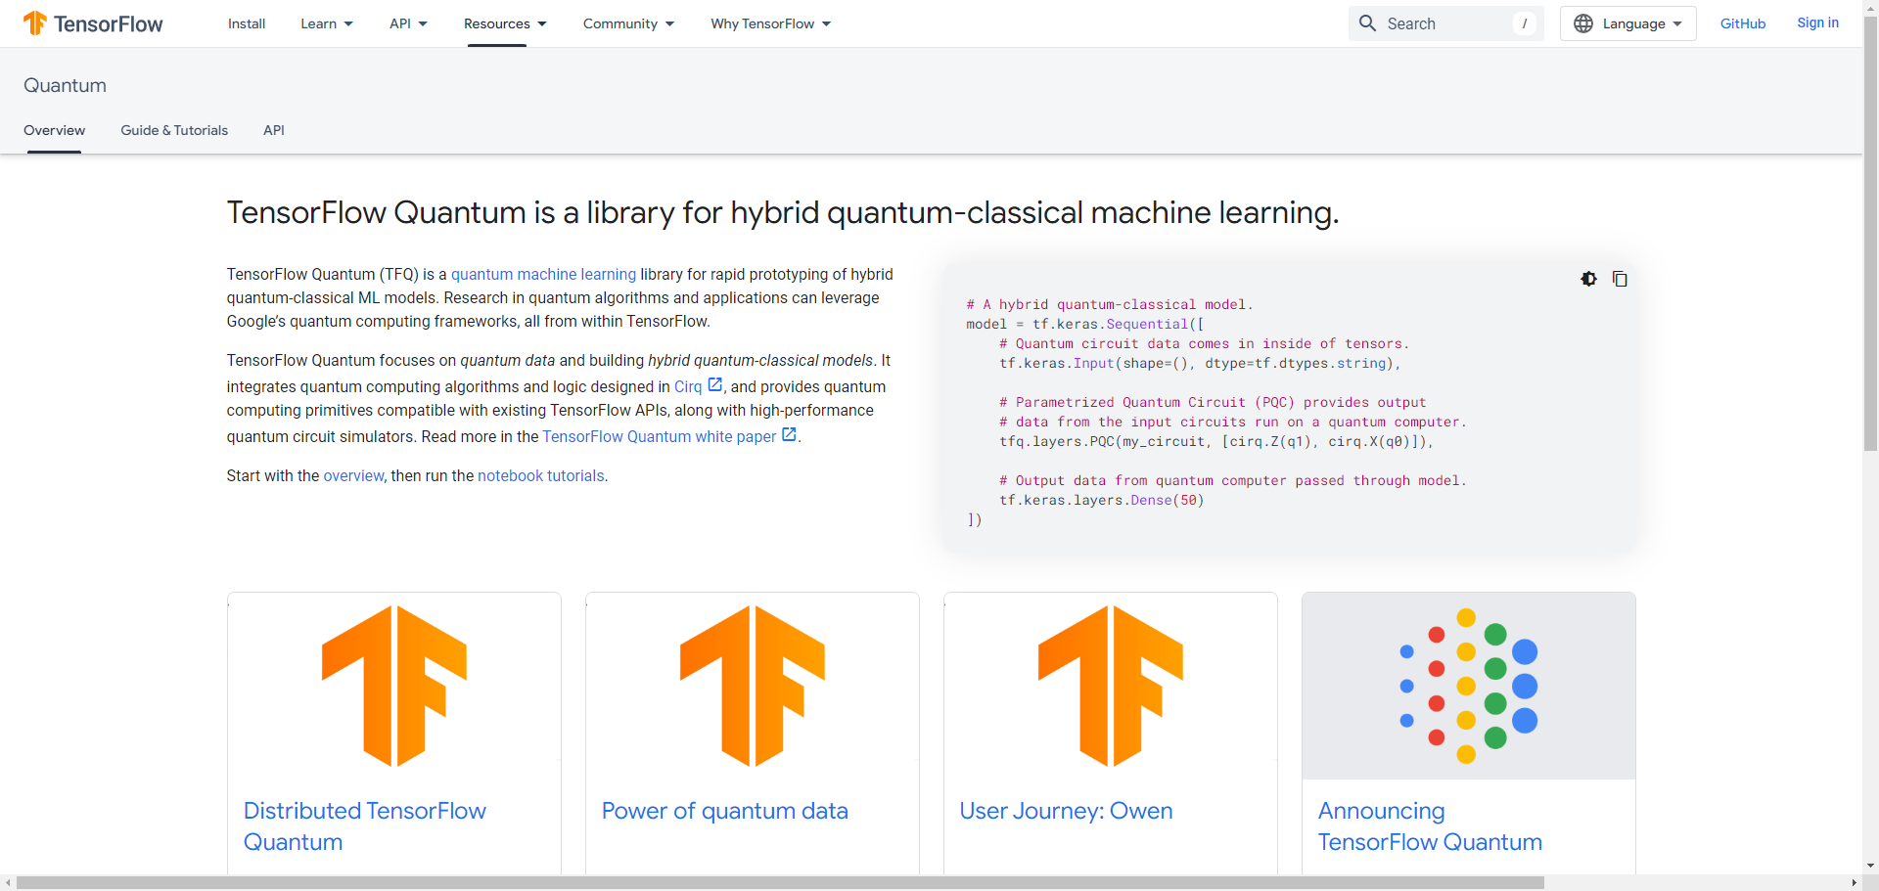
https://www.tensorflow.org/quantum

Slide 4
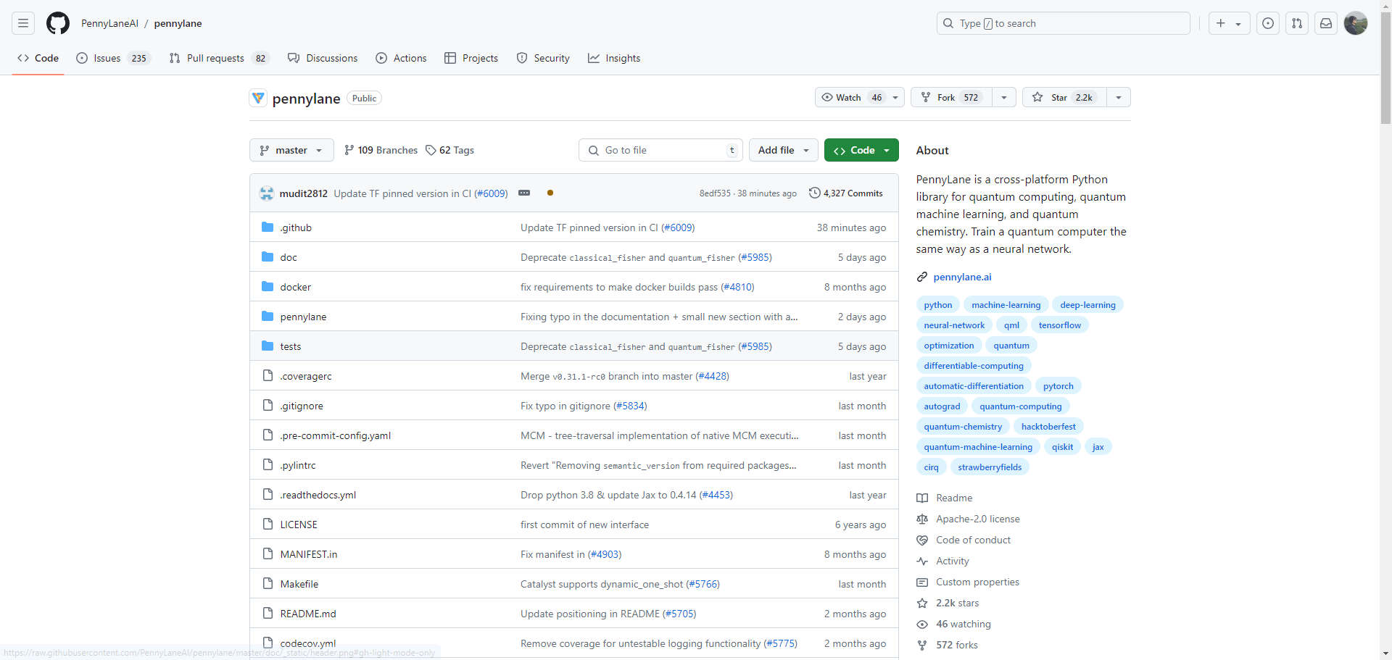
https://github.com/PennyLaneAI/pennylane

Slide 5
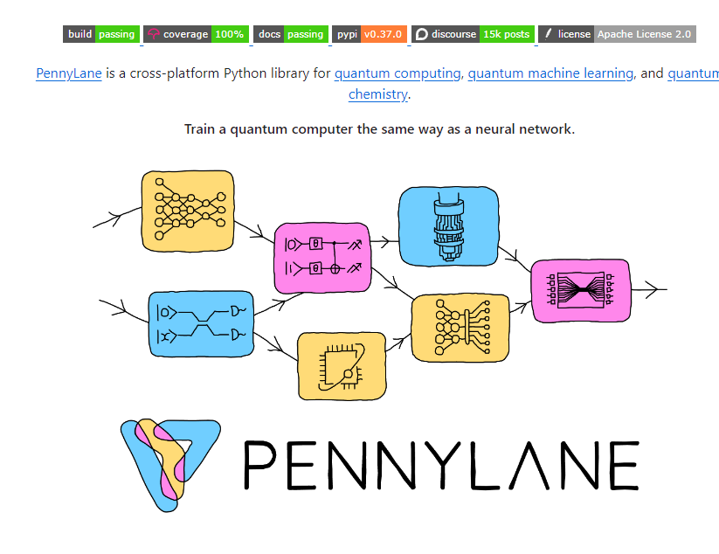
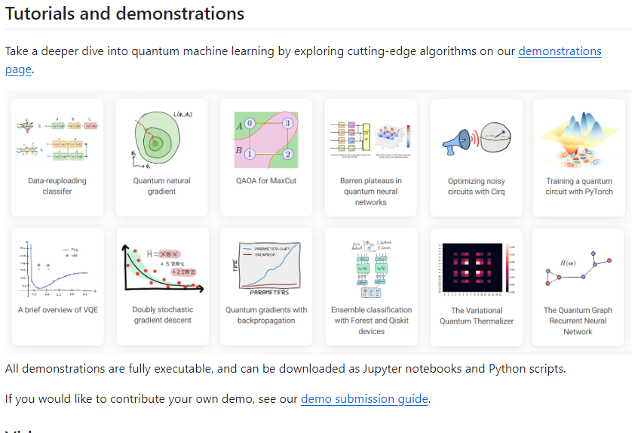
https://github.com/PennyLaneAI/pennylane

Slide 6
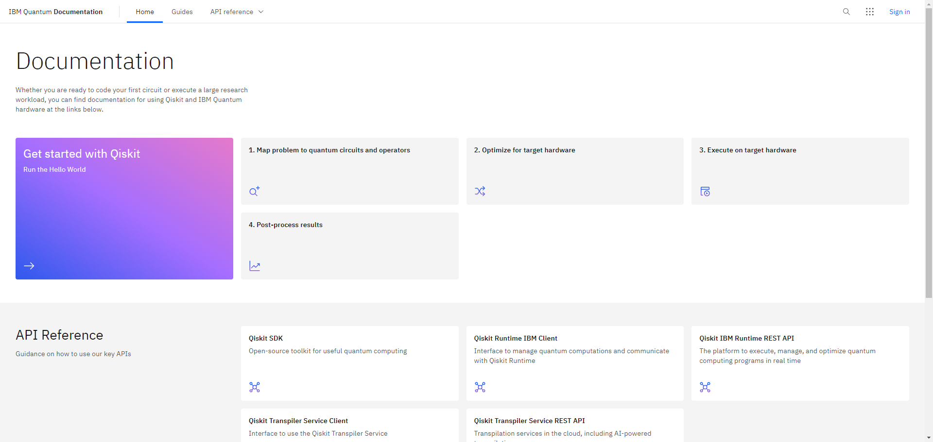
https://docs.quantum.ibm.com/

Slide 7
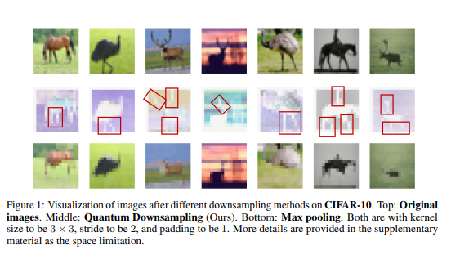
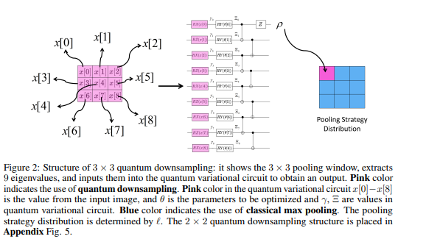
Hybrid Quantum Downsampling Networks
https://arxiv.org/pdf/2405.16375

Slide 8
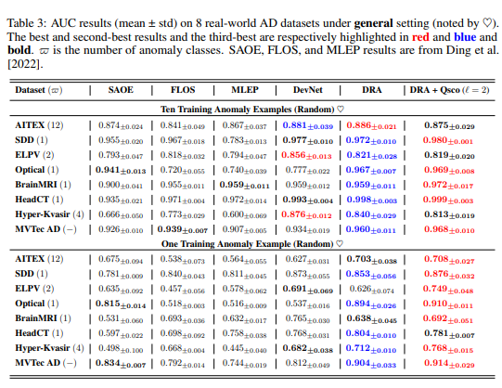
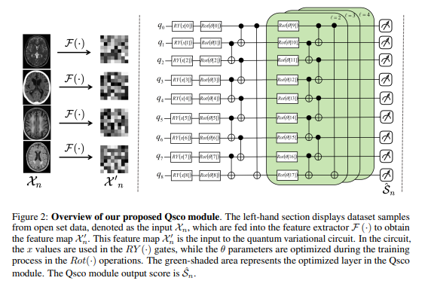
Qsco: A Quantum Scoring Module for Open-set
Supervised Anomaly Detection
https://arxiv.org/pdf/2405.16368

Slide 9
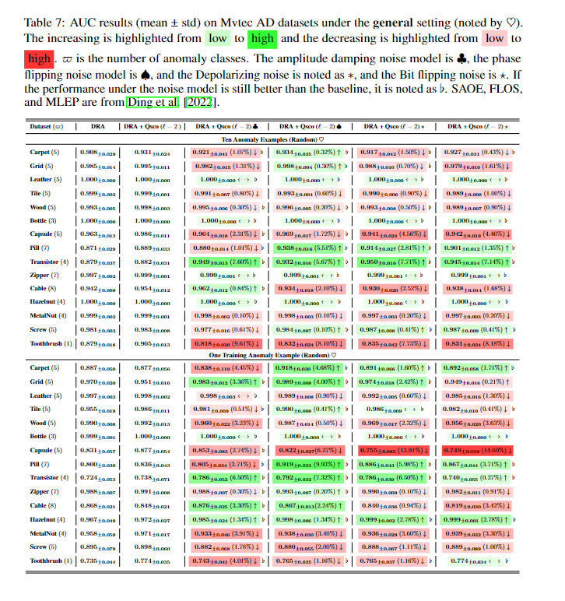
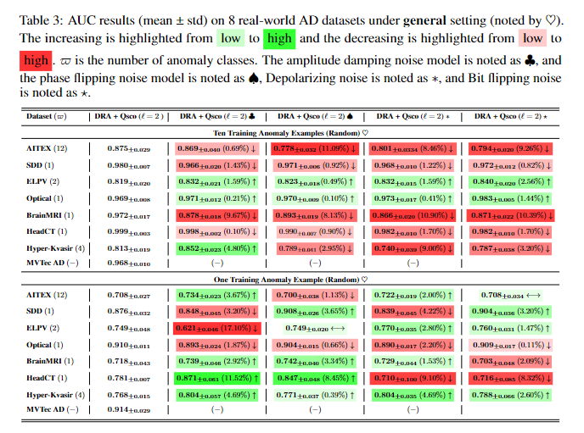

Slide 10
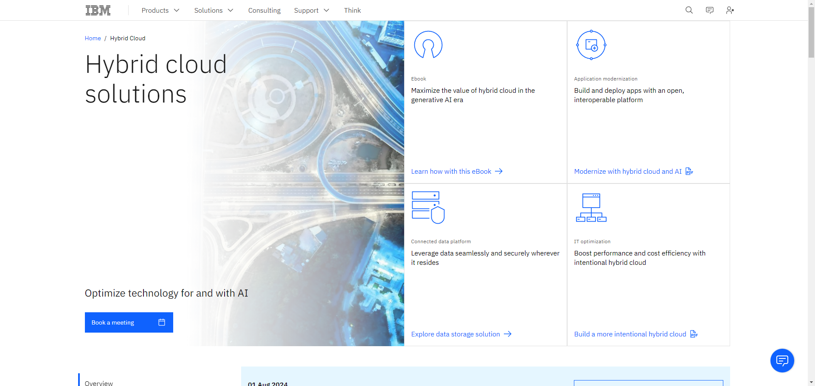
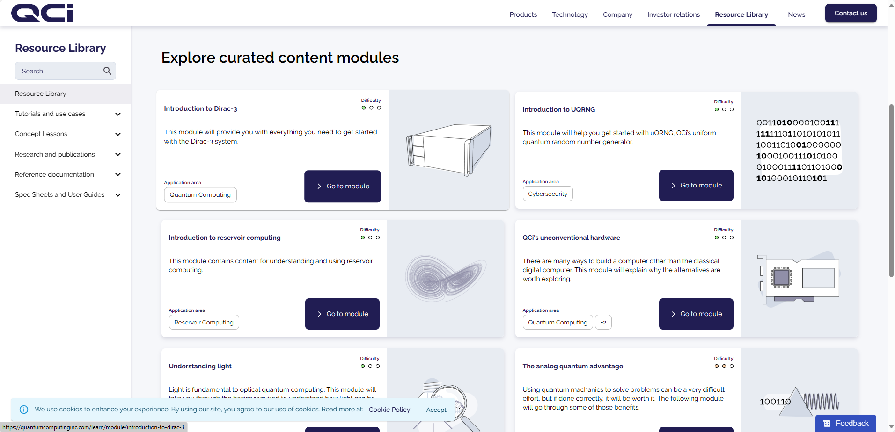
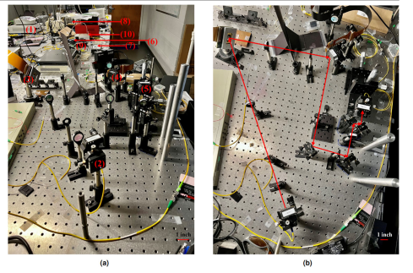
Future Work

